Slide 1
Sleep Health and Lifestyle Analysis
Insights from the Sleep Health and Lifestyle Dataset
Data Scientist: Luis Feliu
© 2024 Udacity.

Slide 2
Agenda
Results of sleep health and lifestyle analysis
Data Description
Physical Activity
Daily Steps
Distribution of Heart Rates

Slide 3
Data Description
The dataset includes the following: gender, age, occupation, sleep duration, quality of sleep, physical activity level, stress level, BMI category, blood pressure, heart rate, daily steps, sleep disorder.
Continuous variable: sleep duration​
Integer variable: daily steps​, age, heart rate, physical activity level
Ordinal categorical variable
  Quality of sleep (4 to 9)​
  Stress level (3 to 8)
  BMI category (normal, overweight, obese)
Nominal categorical variable: gender, occupation, sleep disorder

Slide 4
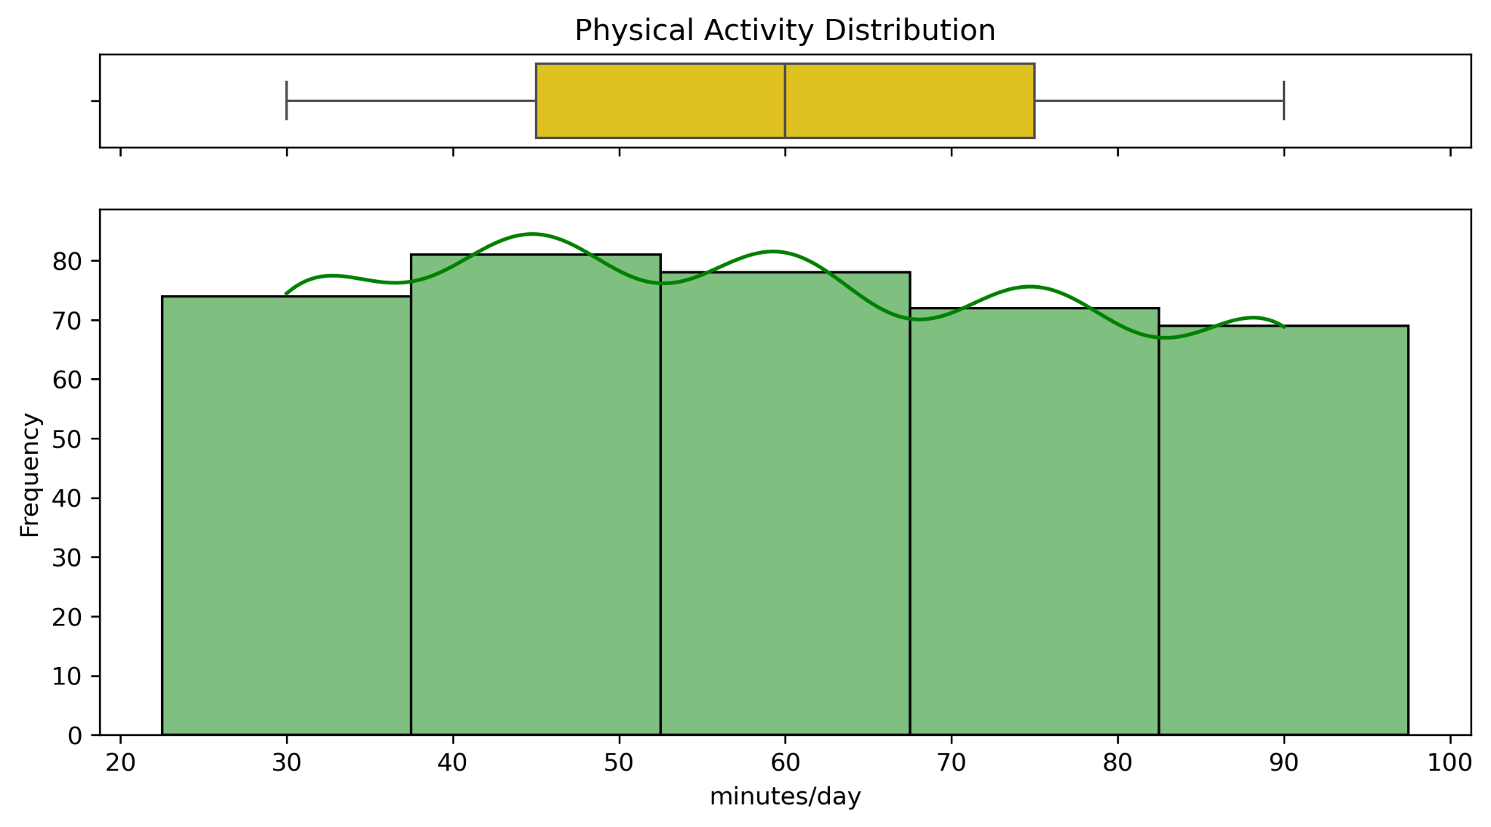
Physical Activity (minutes/day)
Mean: 59.2
Median: 60
Mode: 60
Skewness
negative/left skew: mean (59.2) is slightly less than the median (60)
close to symmetric: mean and median are close (less than a minute difference)

Slide 5
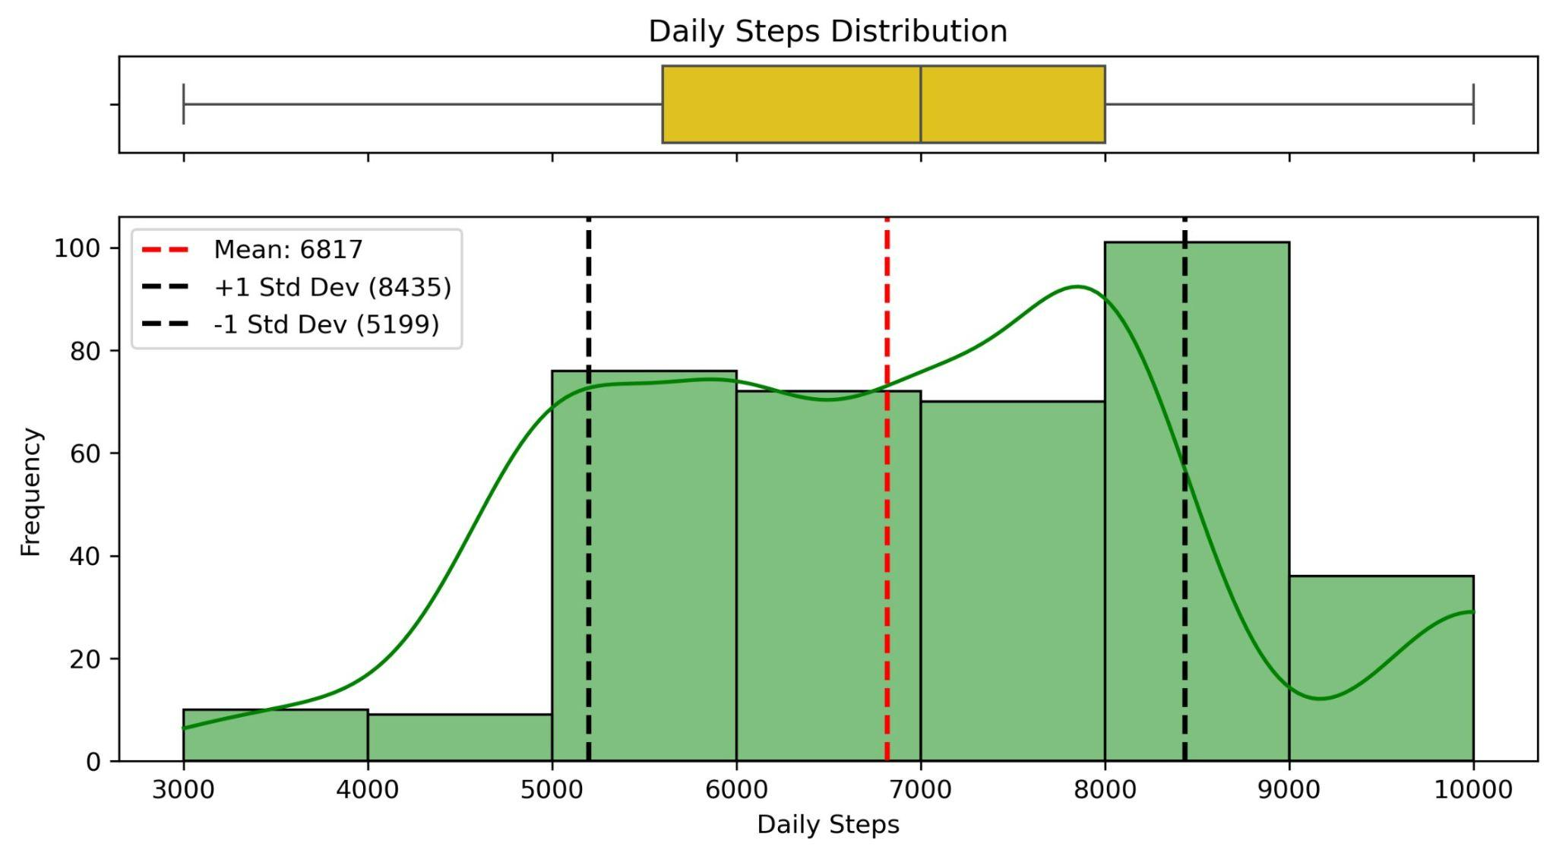
Daily Steps
Mean: 6,816.8
Standard Deviation: 1,617.9
Maximum: 10,000​
Minimum: 3,000
Range: 7,000

Slide 6
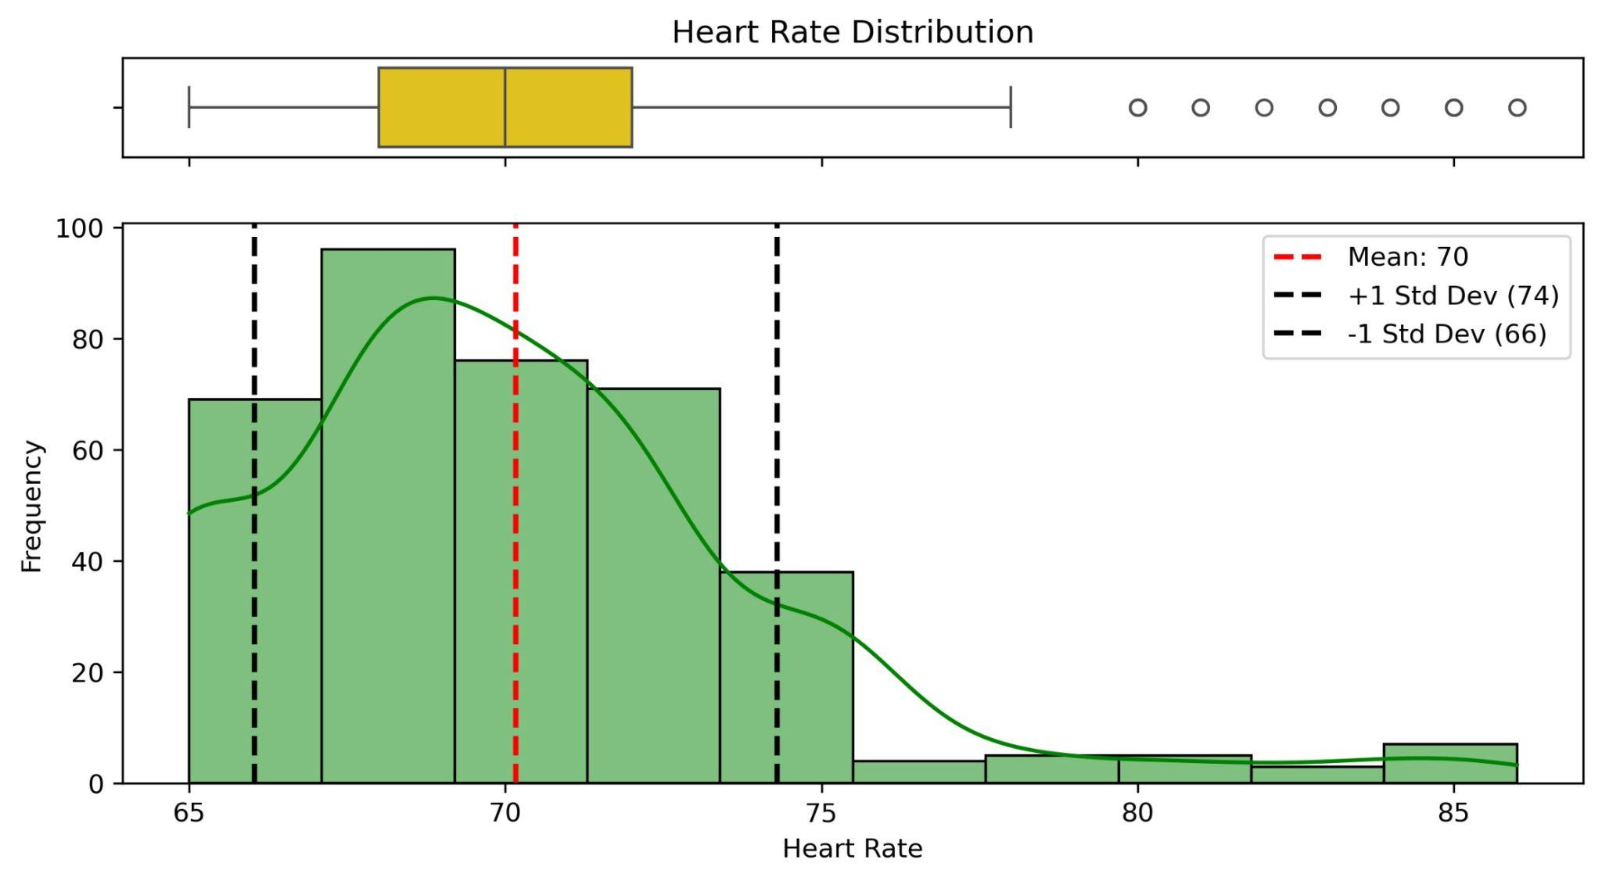
Distribution of Heart Rates
Right-skewed distribution
15 outliers on the higher end (above 78 bpm).

